Slide 1

Design Impact to New Structures
Ed Baznik
Bridge Engineer
Michael Baker International
December 14, 2016

Slide 2
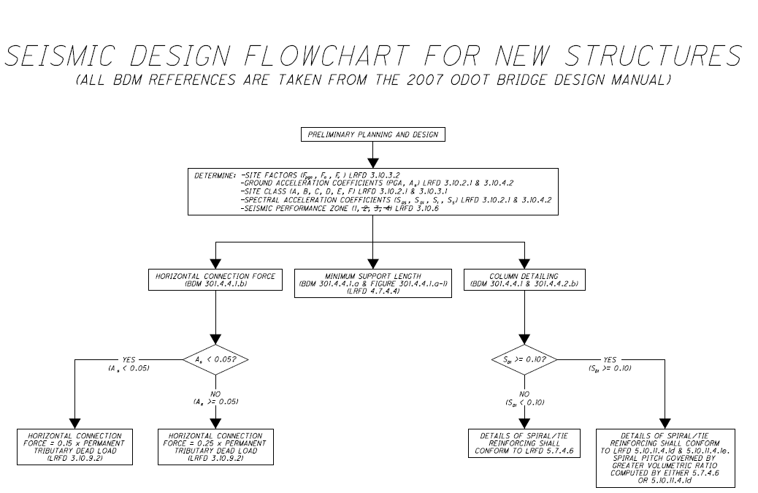
Seismic Hazard Identification
Implications to Structures Design

Slide 3
Design Impact to New Structures
-Minimum Support Length Example #1
-Minimum Support Length Example #2
-Column Detailing Example #1
-Column Detailing Example #2
-Horizontal Connection Force Example
-Support Crossframe Sizing Example

Slide 4
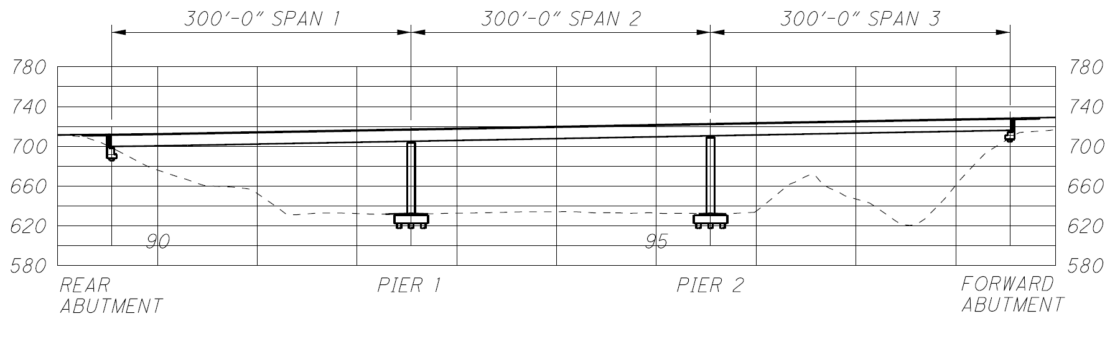
Minimum Support Length Example #1
Notes:
In this session we'll be dealing with 1 and 3, a little of 4 and quite a lot of 5

Slide 5
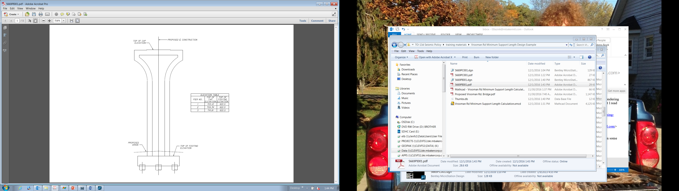
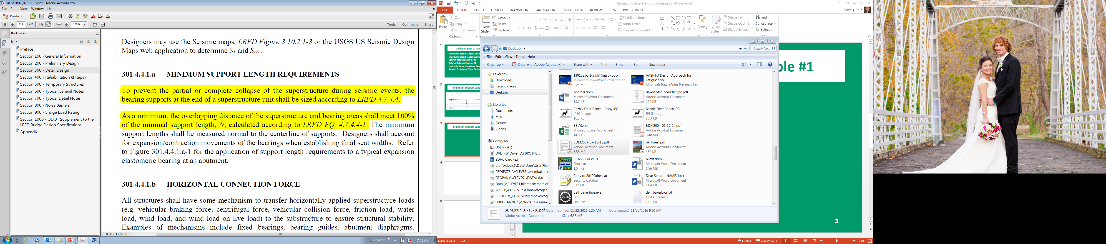
Minimum Support Length Example #1

Slide 6

Minimum Support Length Example #1
According to LRFD 4.7.4.4, the height (H) used in Equation 4.7.4.4-1 is defined as:
-For abutments, the average height of columns supporting the bridge deck from the abutment to the next expansion joint
-For columns and/or piers, column, or pier height
-For hinges within a span, average height of the adjacent two columns or piers
-0.0 for single span bridges

Slide 7
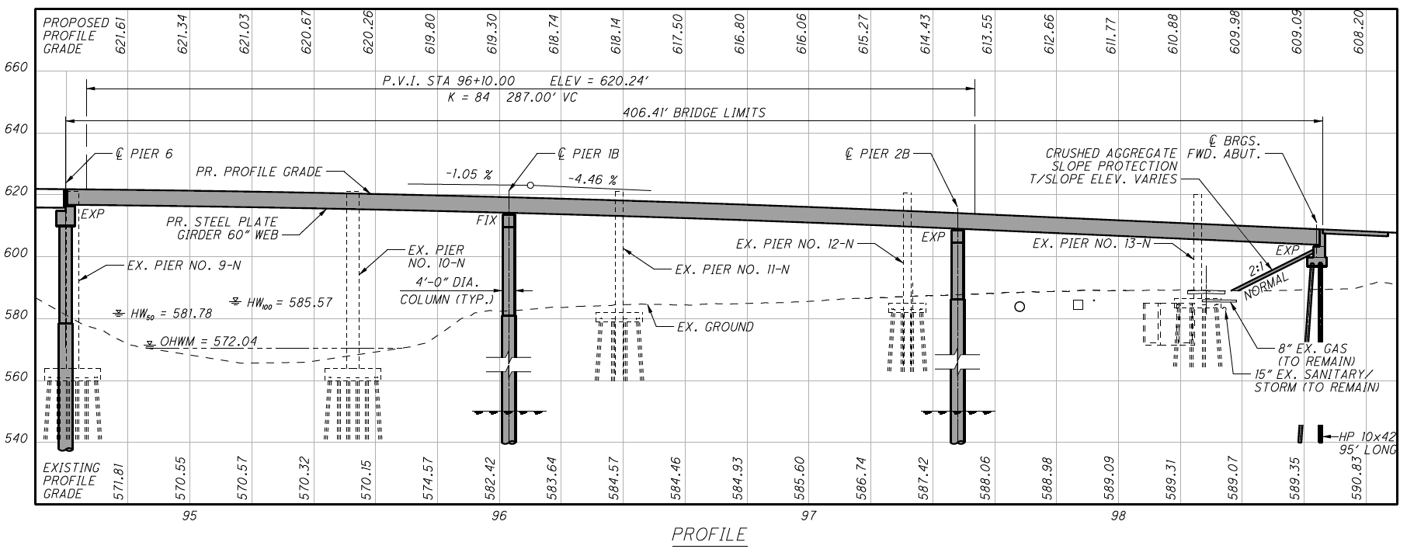
Minimum Support Length Example #2

Slide 8
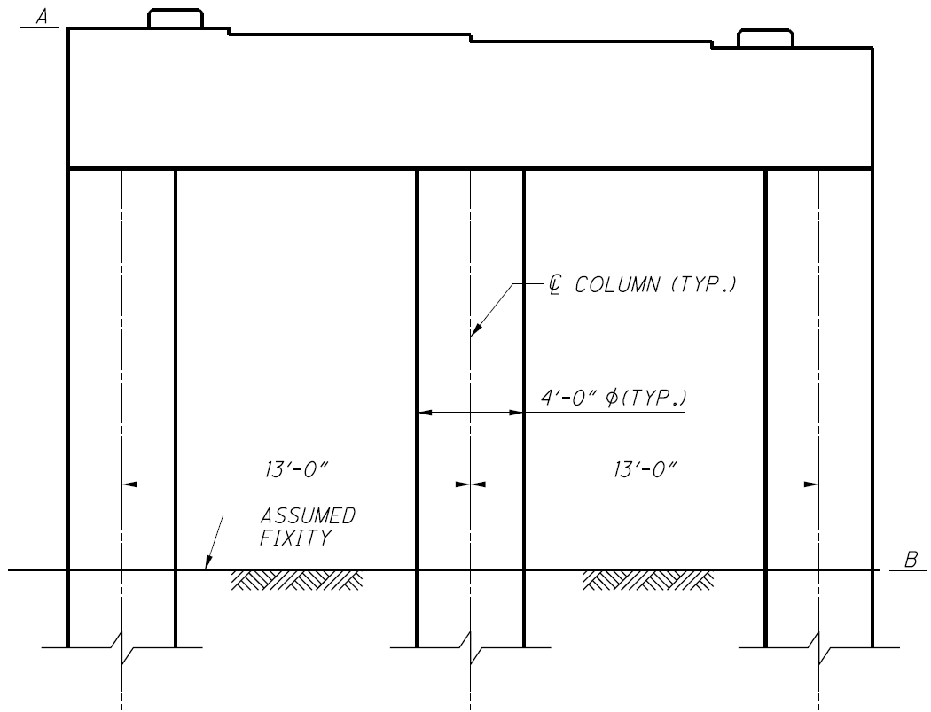
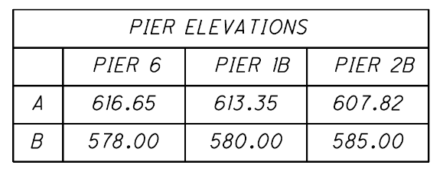
Minimum Support Length Example #2
According to LRFD 4.7.4.4, the height (H) used in Equation 4.7.4.4-1 is defined as:
-For abutments, the average height of columns supporting the bridge deck from the abutment to the next expansion joint
-For columns and/or piers, column, or pier height
-For hinges within a span, average height of the adjacent two columns or piers
-0.0 for single span bridges

Slide 9
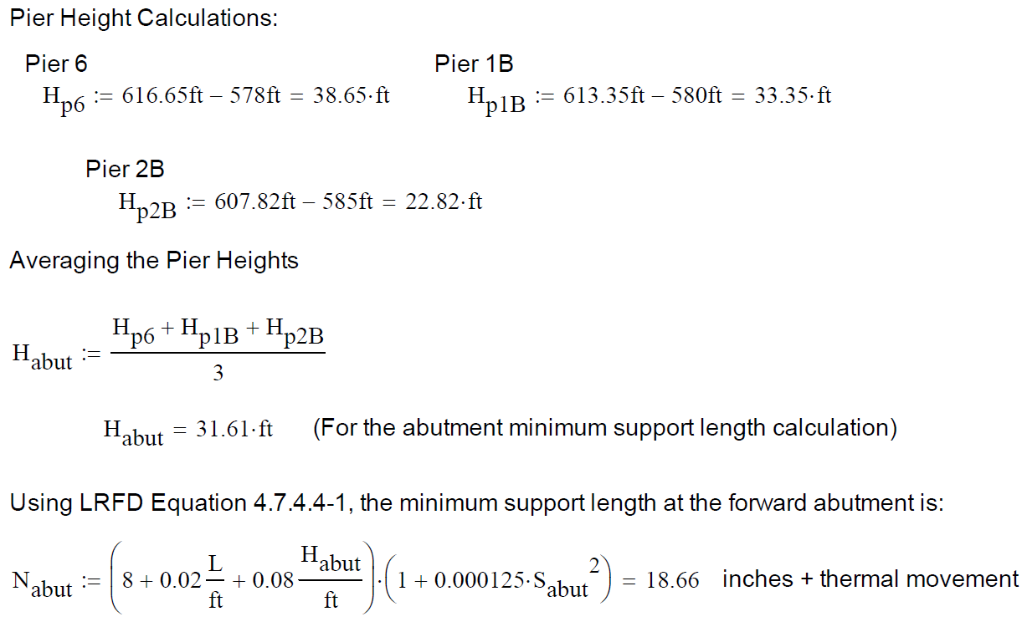
Minimum Support Length Example #2

Slide 10
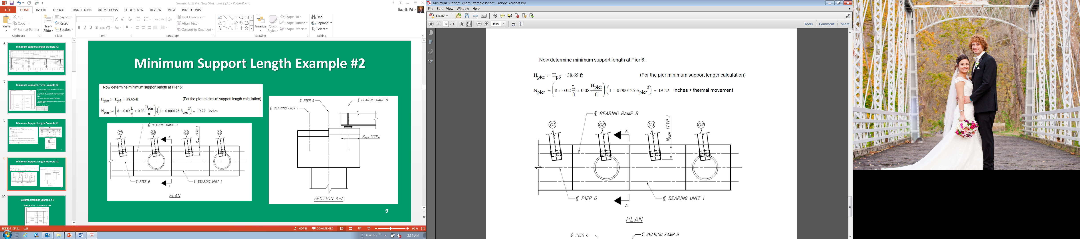
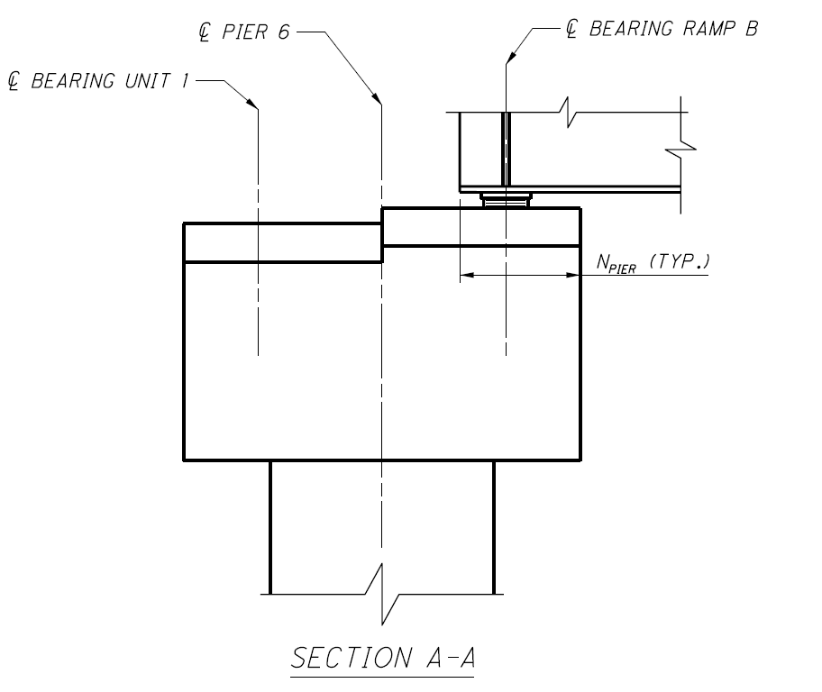
Minimum Support Length Example #2

Slide 11
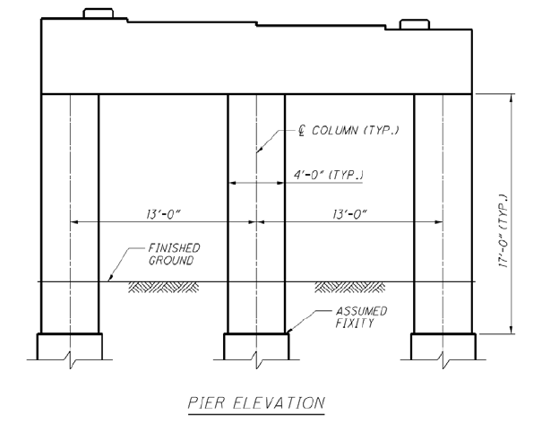
Column Detailing Example #1
Given S_{D1} = 0.07, f’_{c} = 4 ksi and f_{y} = 60ksi

Slide 12
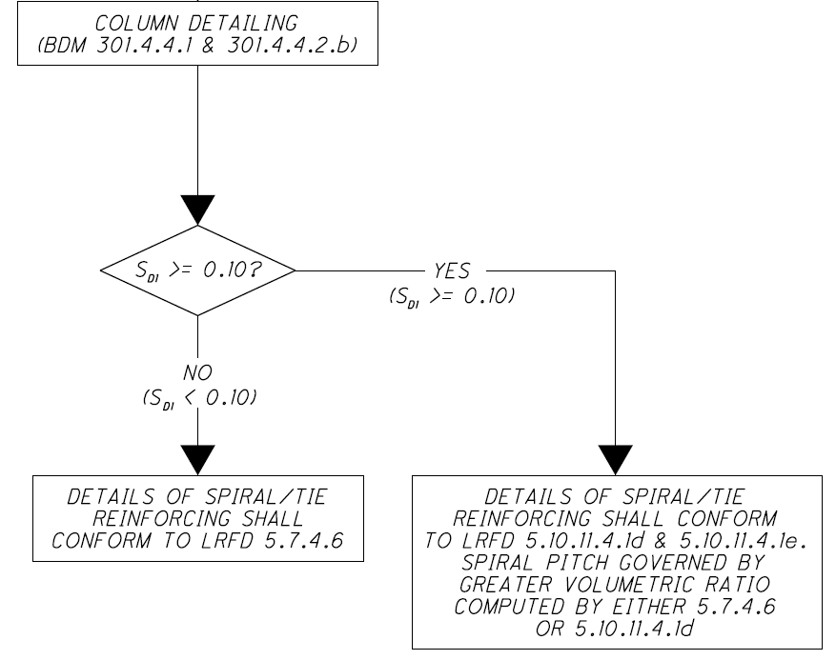
Column Detailing Example #1

Slide 13
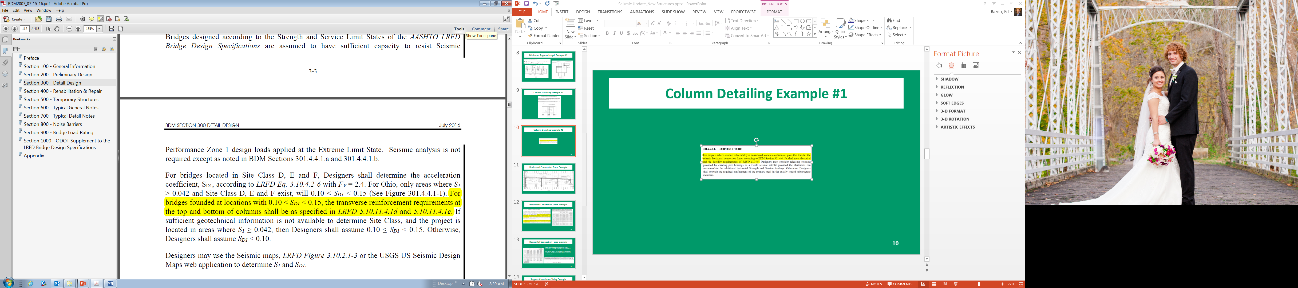
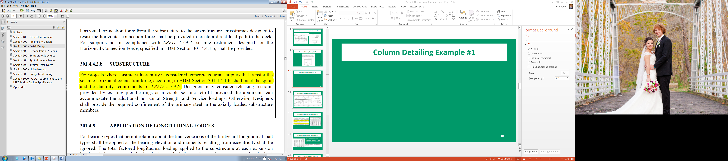
Column Detailing Example #1
From ODOT BDM 301.4.4.1,

Slide 14
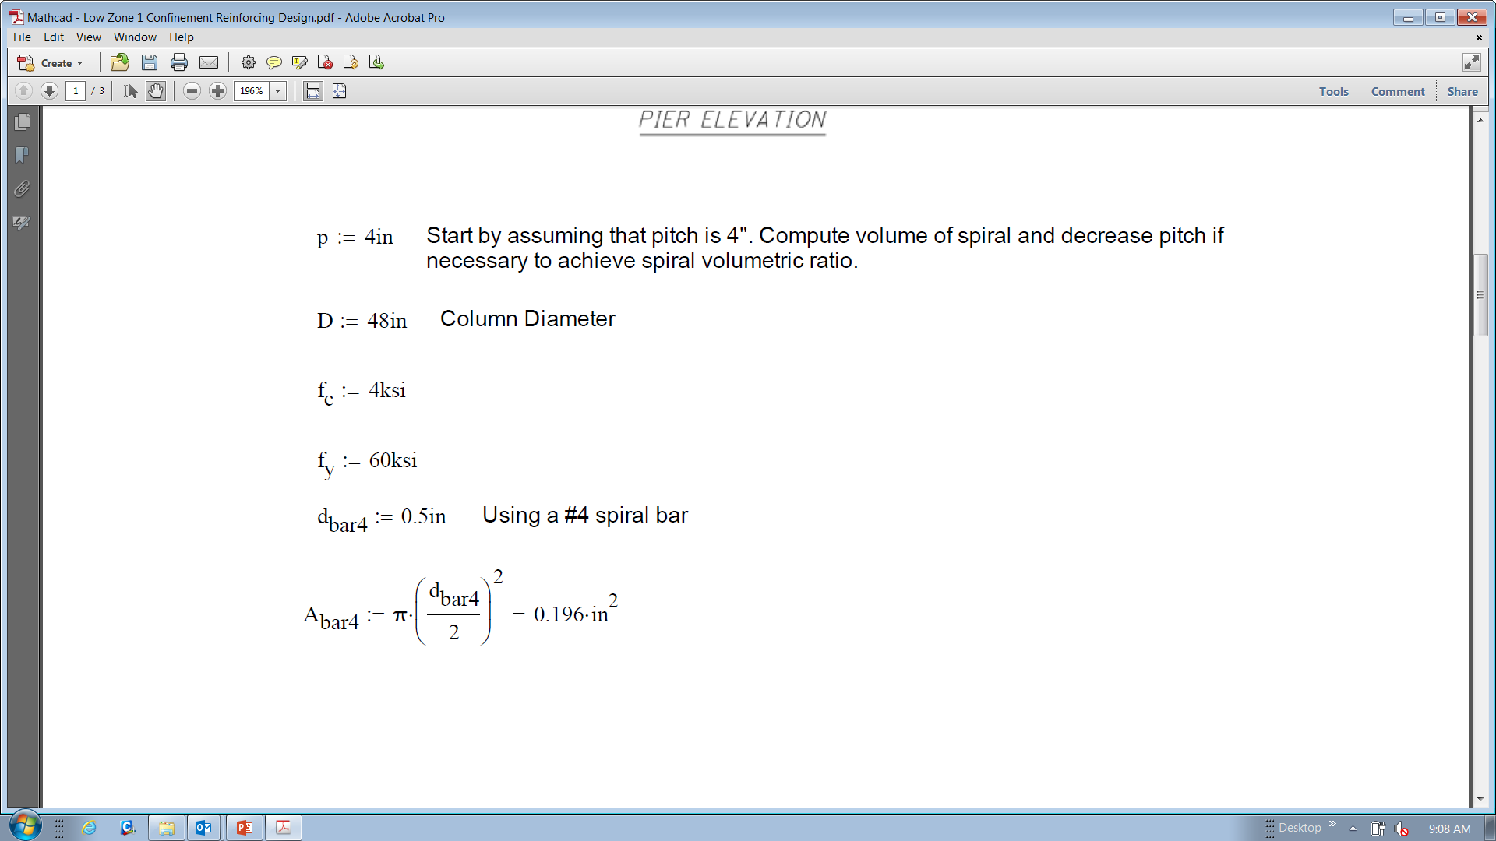
Column Detailing Example #1

Slide 15
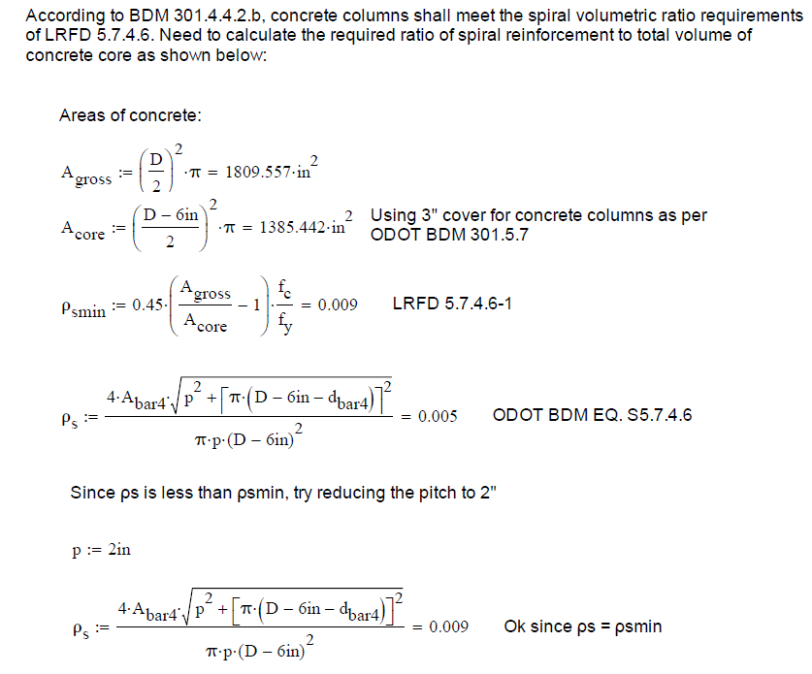
Column Detailing Example #1

Slide 16
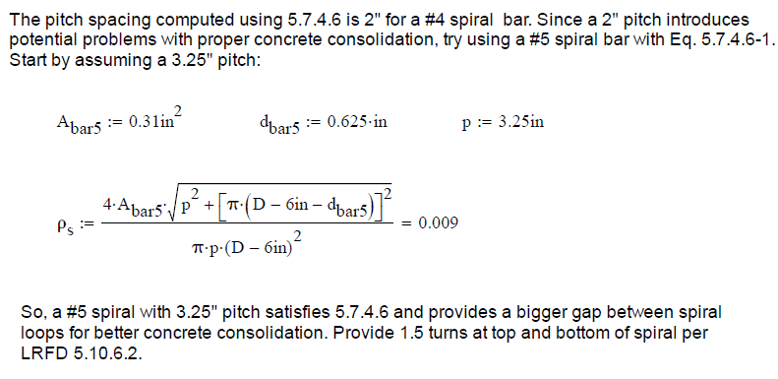
Column Detailing Example #1

Slide 17
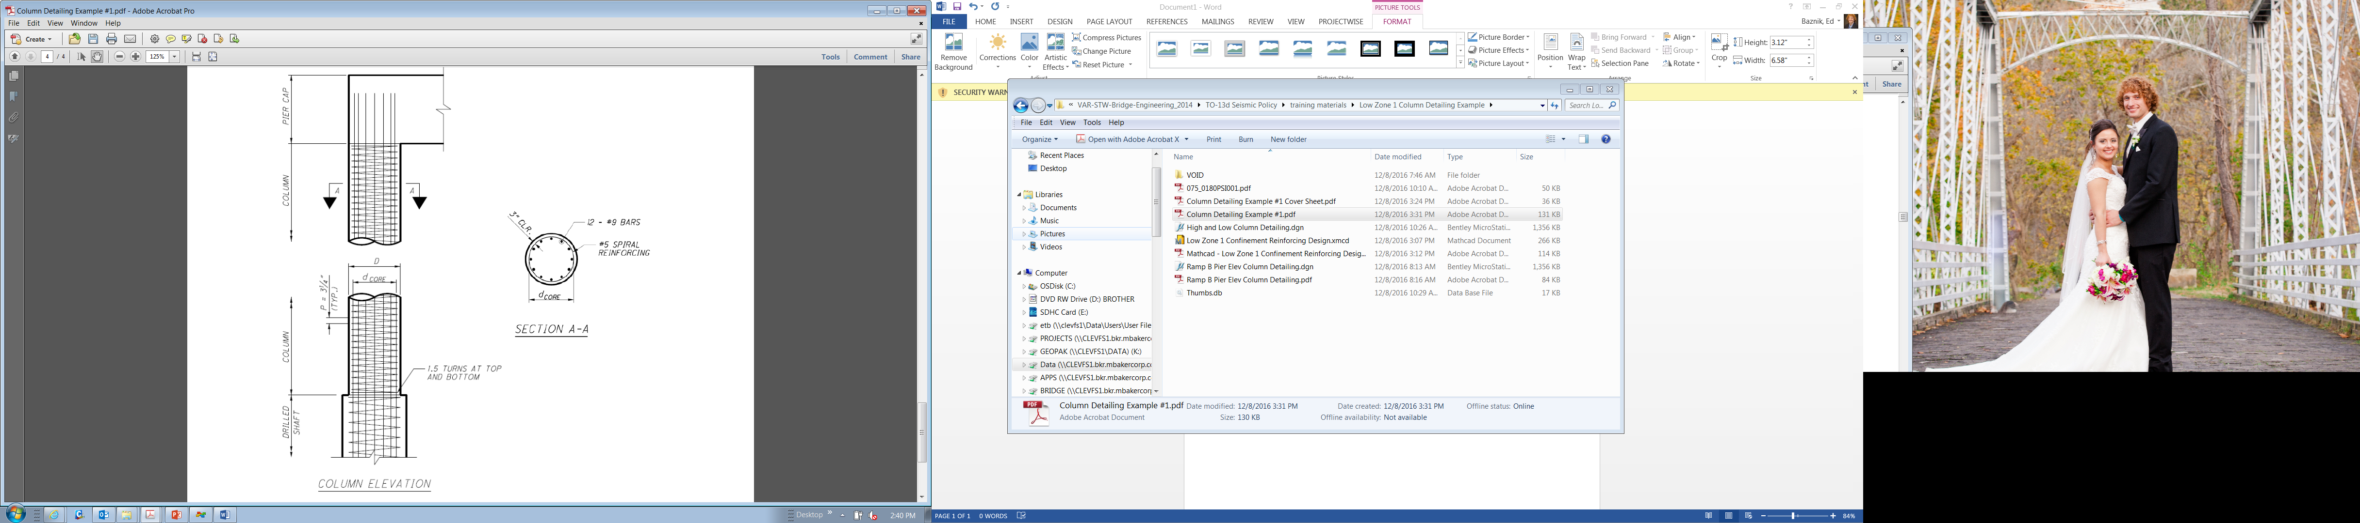
Column Detailing Example #1

Slide 18
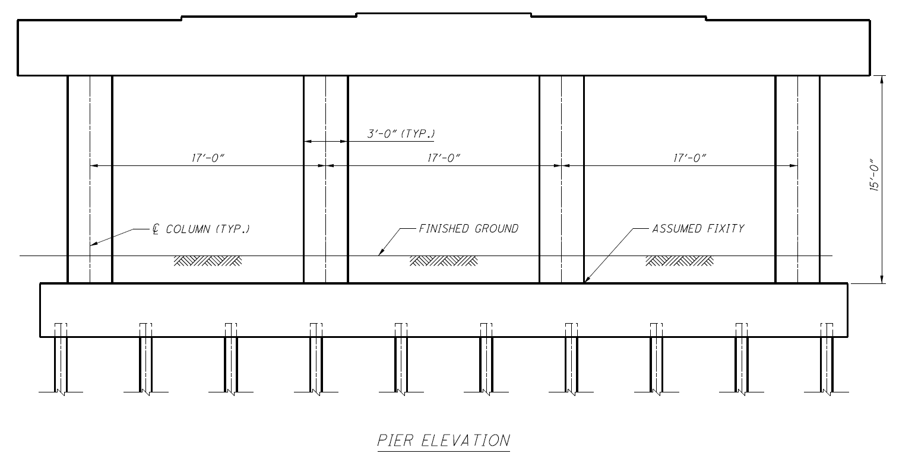
Column Detailing Example #2
Given S_{D1} = 0.12, f’_{c} = 4 ksi and f_{y} = 60ksi

Slide 19
Column Detailing Example #2

Slide 20
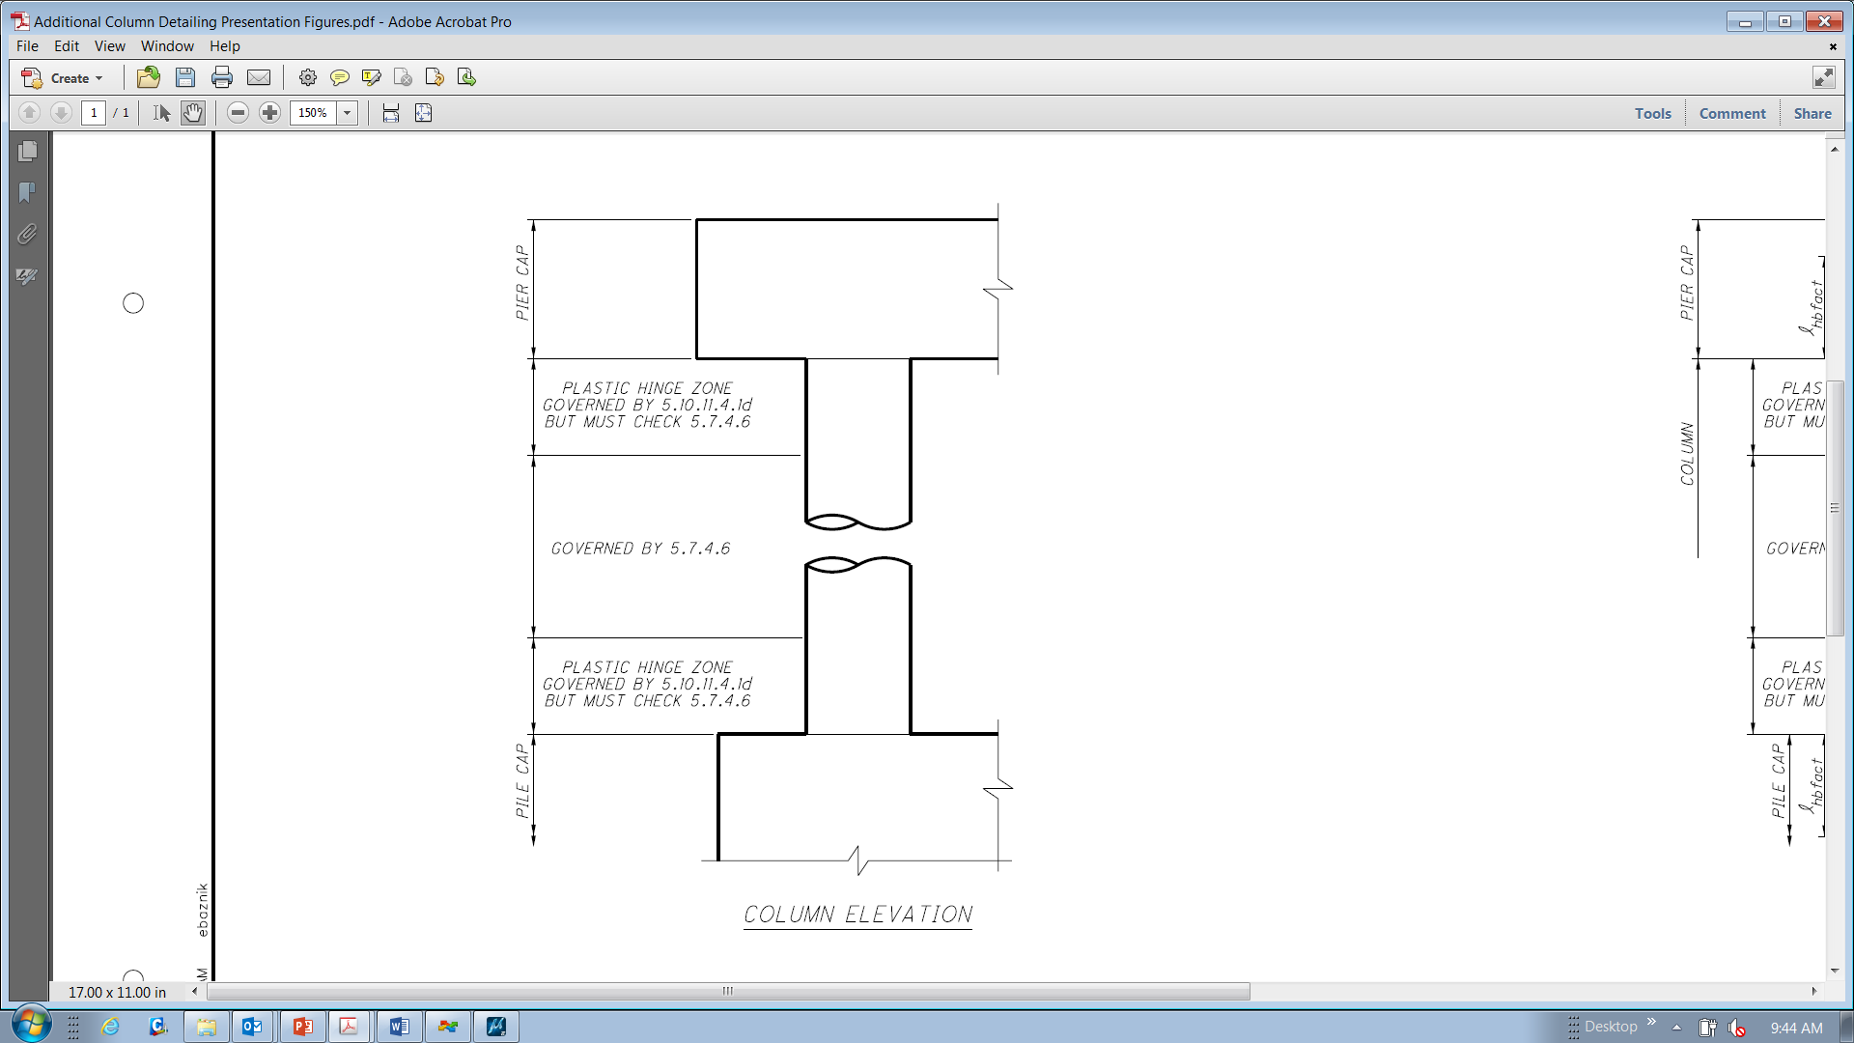
Column Detailing Example #2
Start by determining plastic hinge region, length of transverse reinforcing extension into adjoining member, and maximum pitch per LRFD 5.10.11.4.1e.
-Plastic hinge zone is the maximum of: cross section dimension, one sixth of column clear height, or 18”. Use 3’-0”

Slide 21
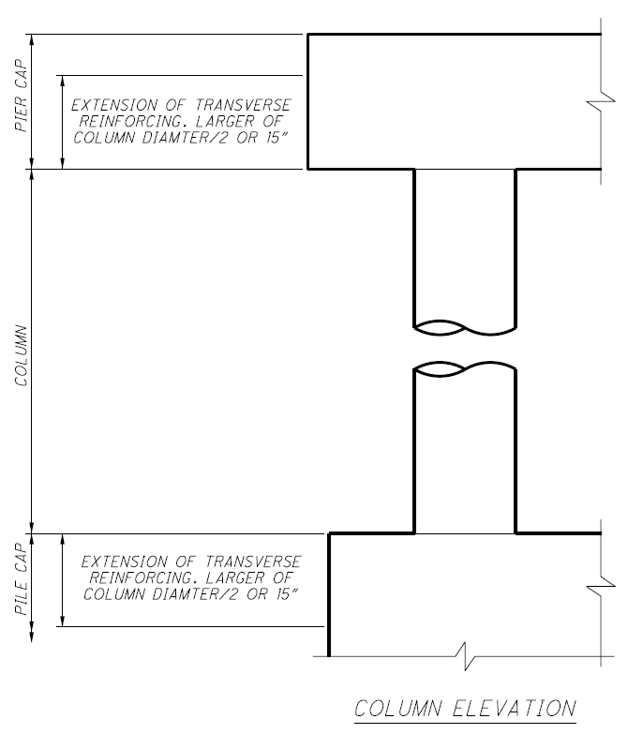
Column Detailing Example #2
Start by determining plastic hinge region, length of transverse reinforcing extension into adjoining member, and maximum pitch per LRFD 5.10.11.4.1e.
-Extend transverse reinforcing into top and bottom connections not less than one half the maximum column dimension or 15”. Use 18”

Slide 22
Column Detailing Example #2
Start by determining plastic hinge region, length of transverse reinforcing extension into adjoining member, and maximum pitch per LRFD 5.10.11.4.1e.
-Transverse reinforcement shall be spaced not to exceed one quarter of the minimum member dimension or 4” center to center. Use 4”

Slide 23
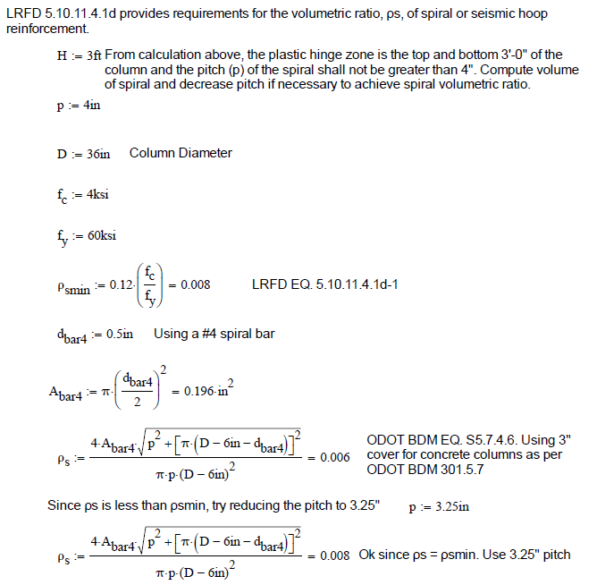
Column Detailing Example #2

Slide 24
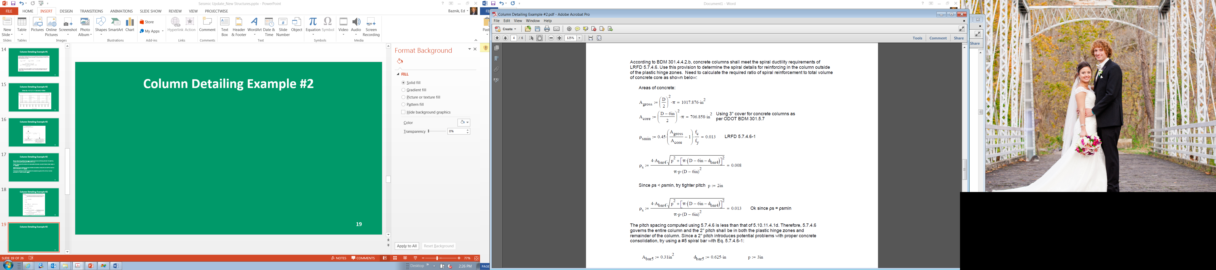
Column Detailing Example #2

Slide 25
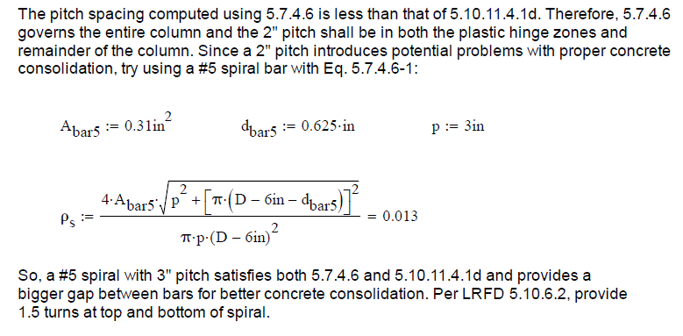
Column Detailing Example #2

Slide 26
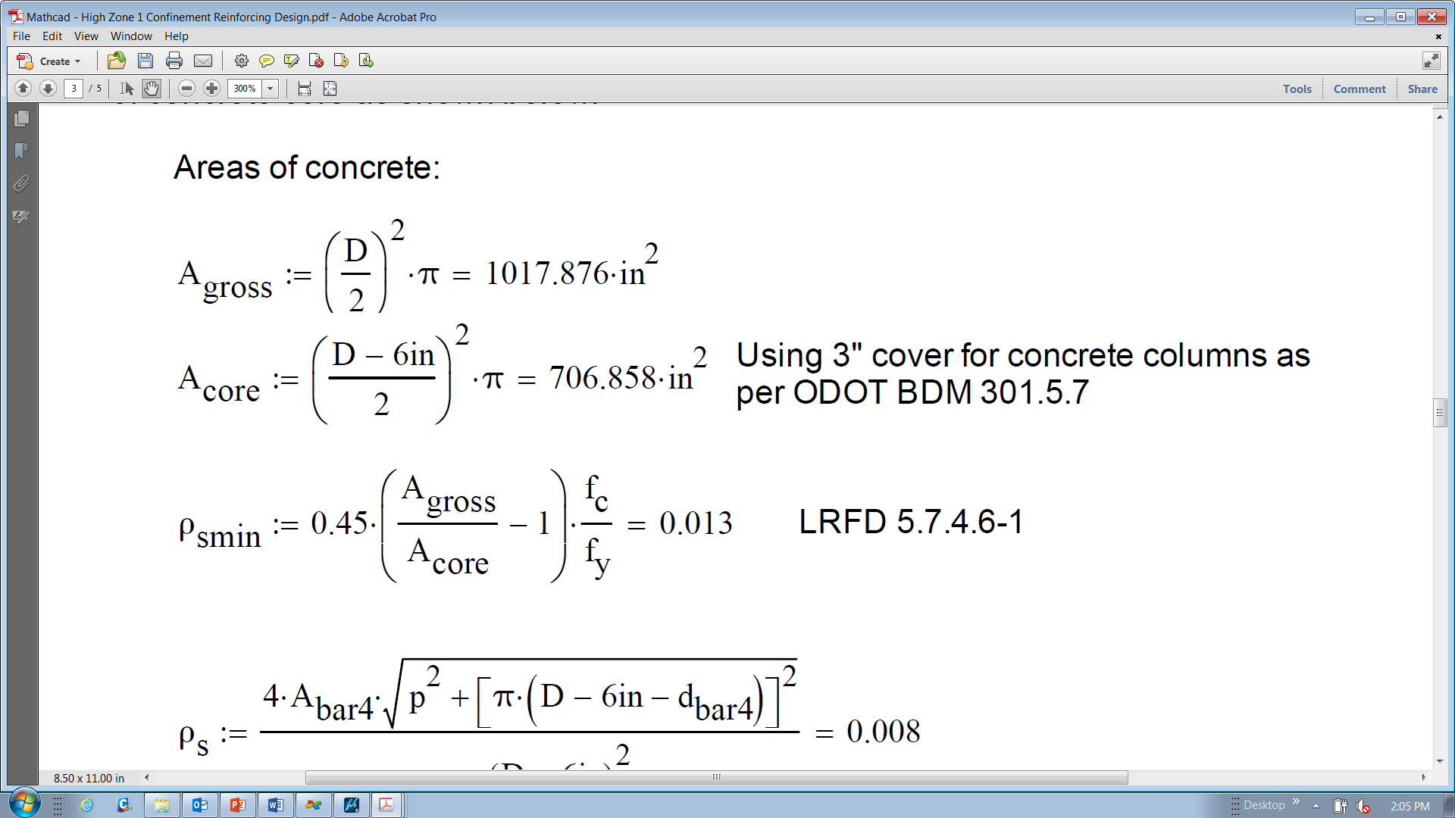
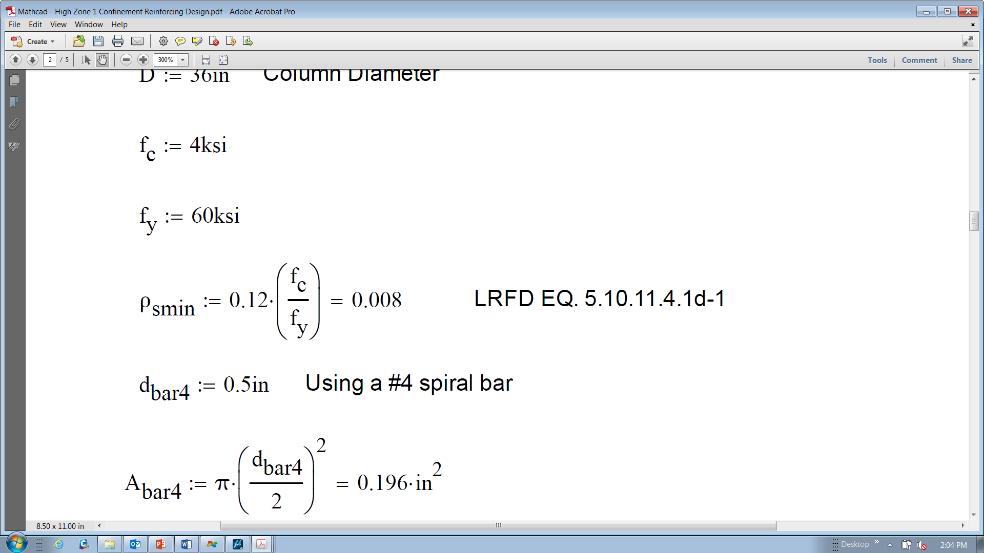
Column Detailing Example #2
LRFD 5.7.4.6 vs. LRFD 5.10.11.4.1d
-For columns with 2” cover, these two equations result in very similar volumetric ratios. When 3” of cover is used, 5.7.4.6 governs for the most commonly used column diameters.

Slide 27
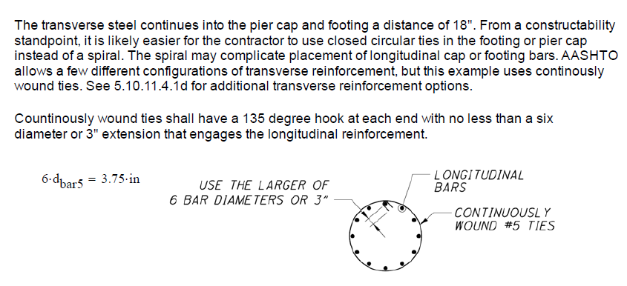
Column Detailing Example #2
-Transverse reinforcing extension into adjoining member per LRFD 5.10.11.4.1e & 5.10.11.4.3

Slide 28
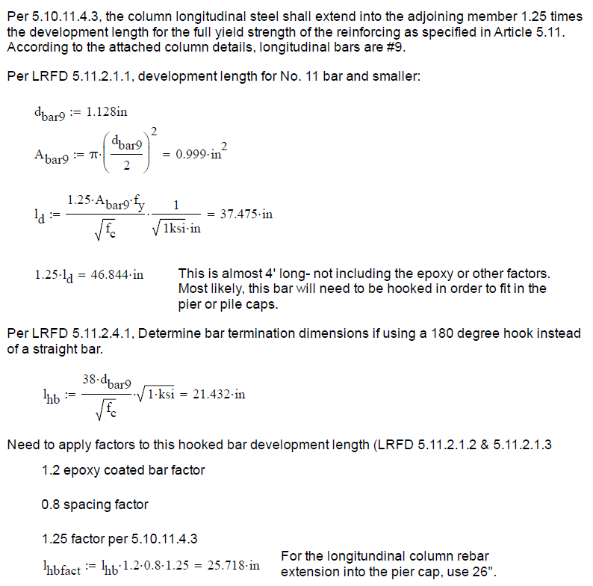
Column Detailing Example #2

Slide 29
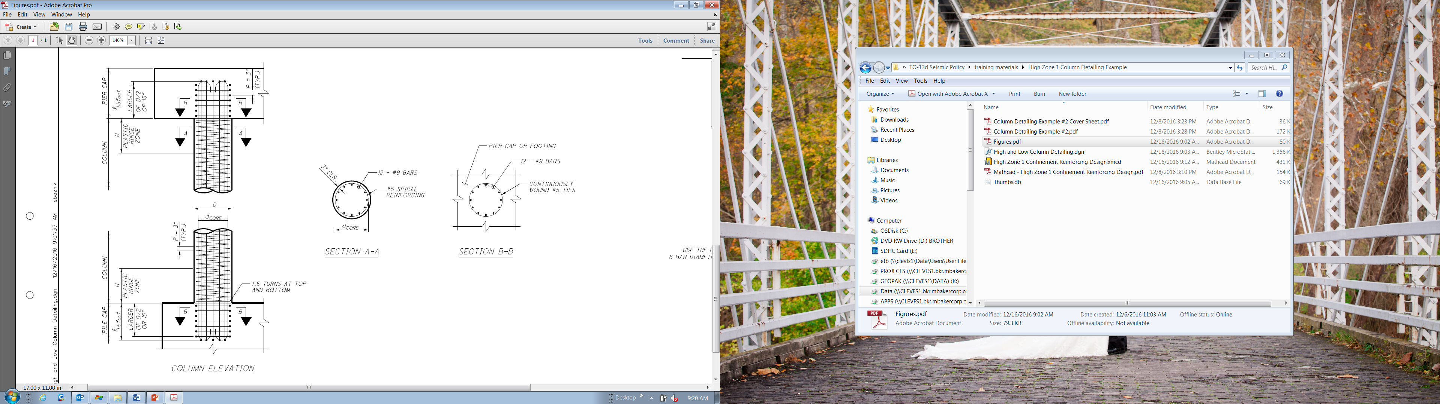
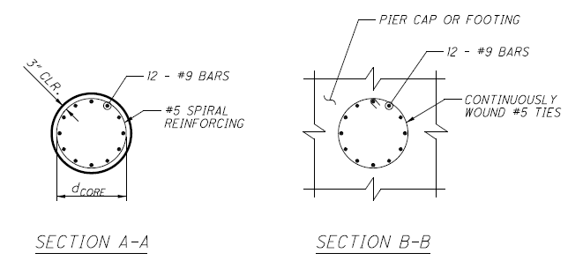
Column Detailing Example #2

Slide 30
Horizontal Connection Force Example

Slide 31
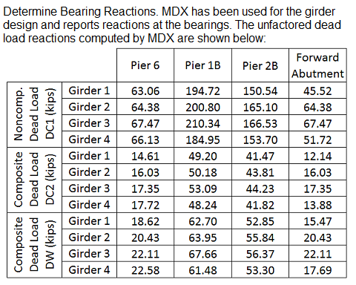
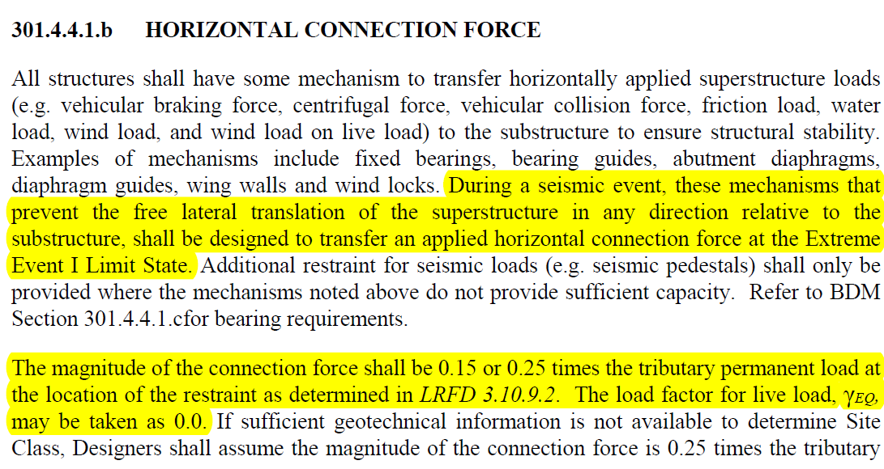
Horizontal Connection Force Example
This ramp bridge is located in Seismic Performance Zone 1 and has an acceleration coefficient, As, of 0.064. The transverse section consists of four plate girders.

Slide 32
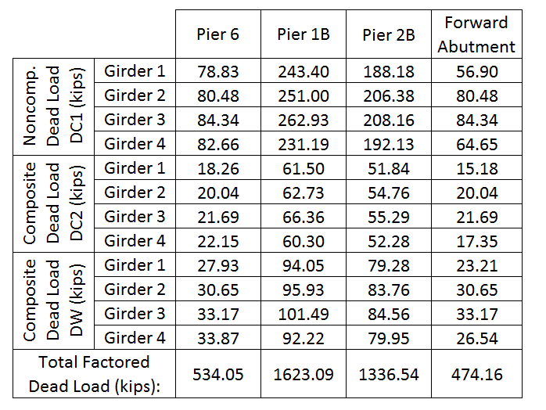
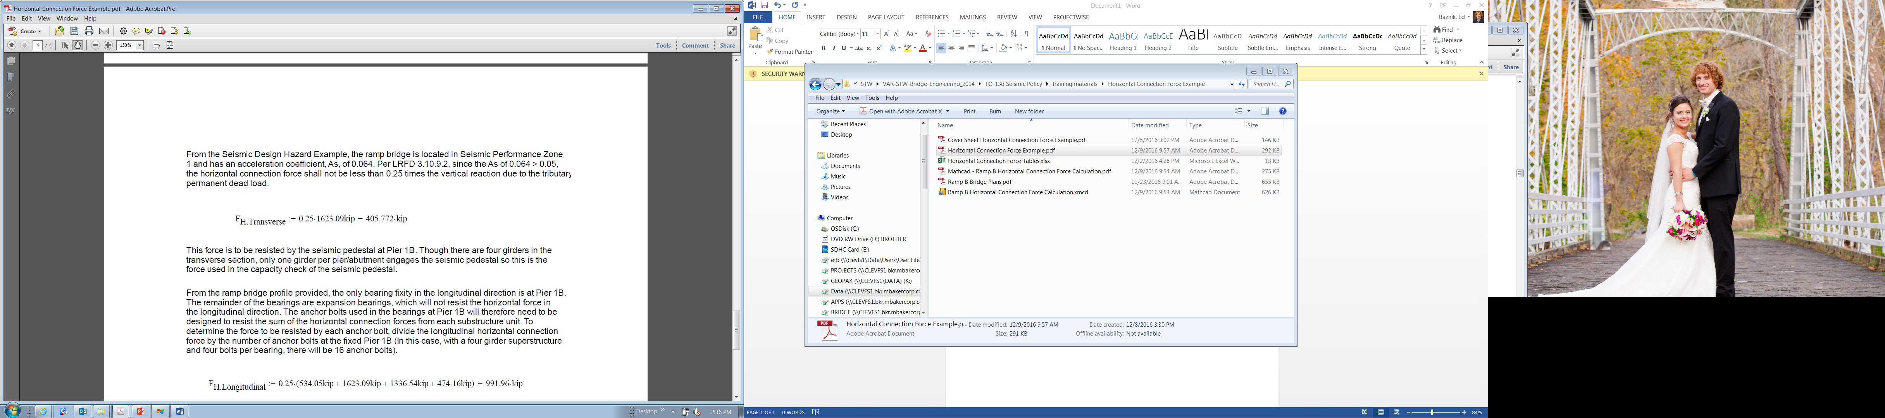
Horizontal Connection Force Example
Factor the dead load at the Extreme Event I Load Combination using LRFD Table 3.4.1-1 and Table 3.4.1-2.
DC1 and DC2 factor is 1.25, DW factor is 1.50. Summing dead loads, Pier 1B governs with the largest permanent total dead load.

Slide 33
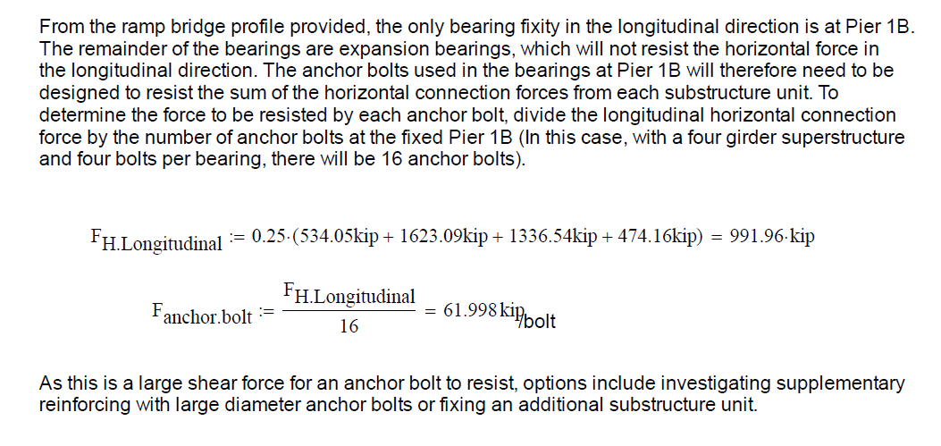
Horizontal Connection Force Example

Slide 34
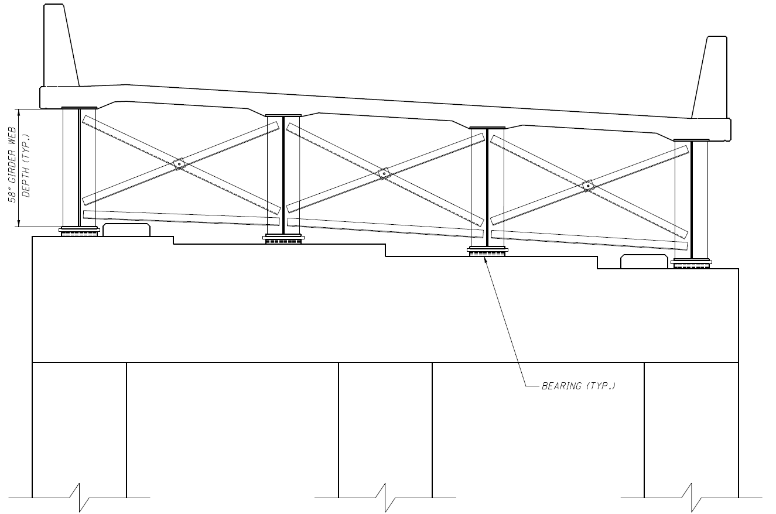
Support Crossframe Sizing Example
According to ODOT BDM 301.4.4.1.b: “Crossframes to resist the horizontal connection force at the Extreme Event Limit State shall be provided to create a direct load path from the point of horizontal connection force application to the deck”
Horizontal
Connection
Force
Ground Motion

Slide 35
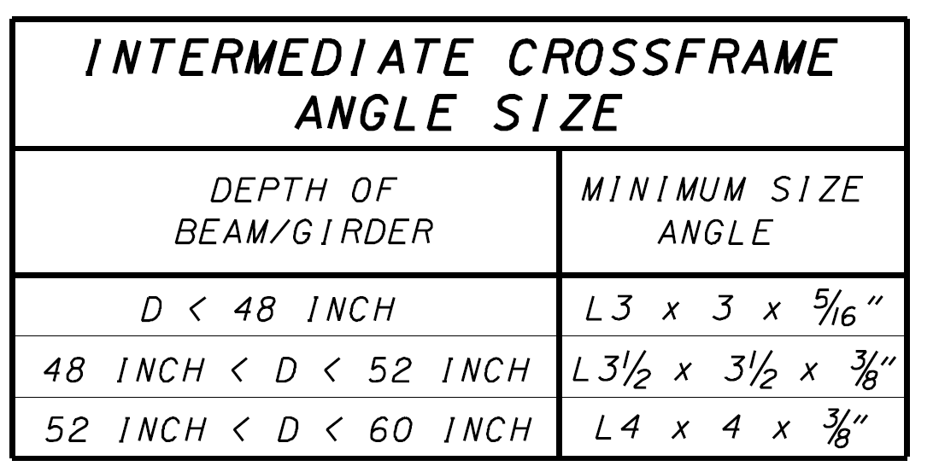
Support Crossframe Sizing Example
Using ODOT Standard Drawing GSD-1-96, a crossframe member size can be selected based upon girder depth.
It is ODOT’s intent that bracing be required at bearings to provide a load path between the substructure and the superstructure, not to require design of crossframes or their connections.

Slide 36
Questions?

